Slide 1
The Enigma Simulator
Elliot Brooks
Notes:
Hello, my name is Elliot and this is a video about my project : The Enigma Simulator.

Slide 2
In this video :
Motivation & Context
Aims
Enigma Roleplay
Notes:
In this video, I will cover the motivation and context surrounding this project – provide its aims – as well as provide a demonstration of the project through roleplay

Slide 3
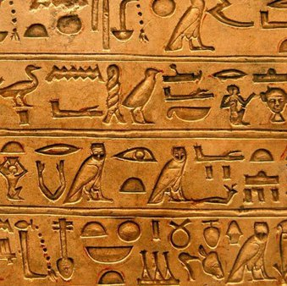
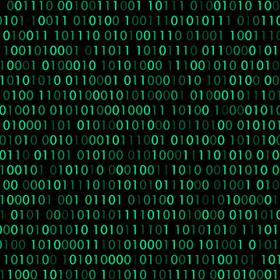
Is this you?
Secret messages?
Protected Data?
Cryptography!
Since 1800 BCE
Notes:
Before we begin, let me ask you a question : Have you ever wanted to keep your messages? Or ensure that your personal data is kept secret? If the answer is yes, then you are not alone!
Cryptography has been used for data protection and secret communications throughout history. Dating all the way back to 1800 BCE!

Slide 4
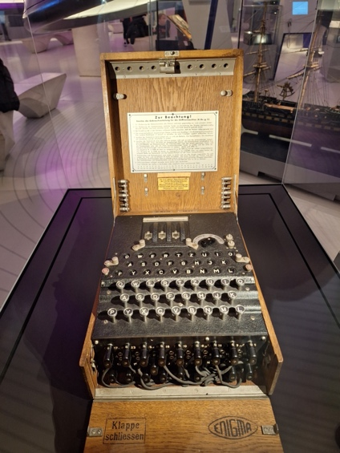
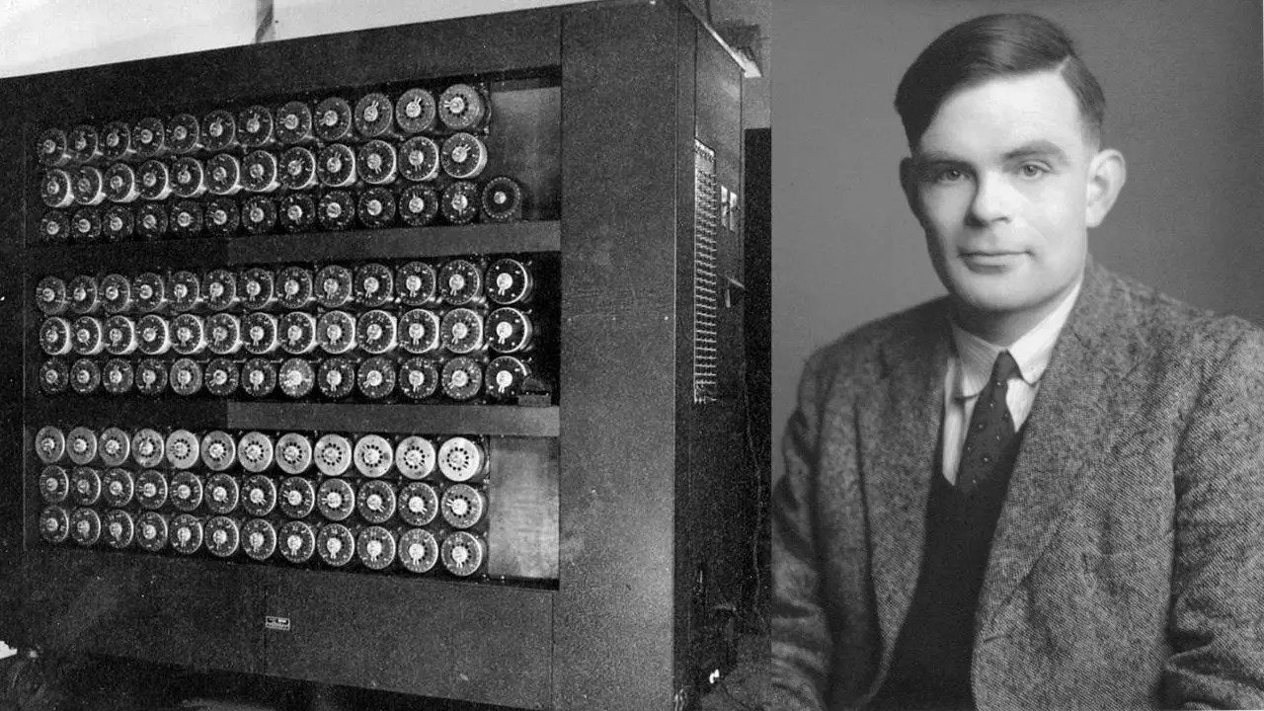
The Enigma Machine
History
A Cypher Machine
Mechanical rotors
Electrical Signals
Encrypts/Decrypts messages
Extensive History
Used by Germans in WW2
Cracked by the Bletchley Park team!
Notes:
The Enigma machine is a huge part of the of history, for both computer science and cryptography, and uses mechanical rotors and electrical signals to encrypt and decrypt messages
It was used extensively by the Germans in WW2 and is most well-known for the eventual breaking of Enigma by the team at Bletchley Park. Hi Alan!

Slide 5
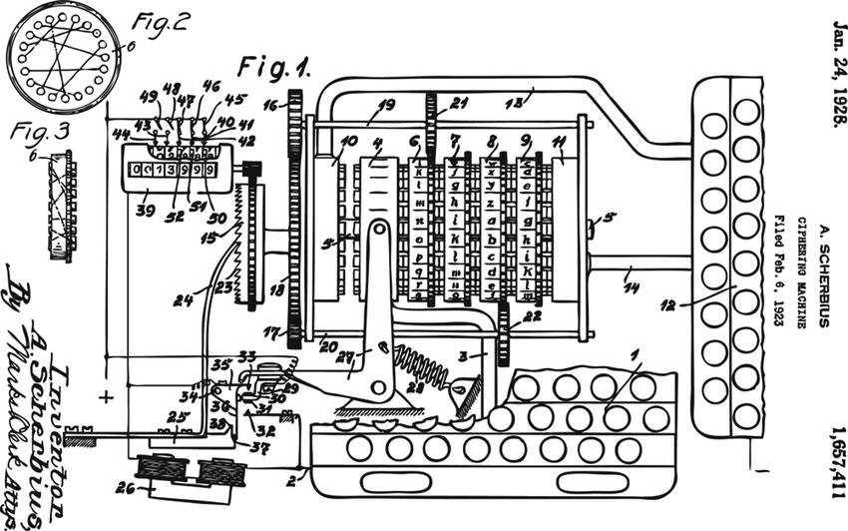
?
?
?
Notes:
Despite the fame surrounding this machine, the mechanism of Enigma still remain a mystery/enigma to most.

Slide 6
How does Enigma work?
Electrical Signals
Mechanics
Keyboard
Plugboard
3x Rotors
Reflector
Lampboard
Rotors rotate every keypress
Causing wiring to change
Causing letter mapping to change
One letter can be encrypted to multiple different letters in a single message!
Up to x9 letter scrambling!
Notes:
So how does Enigma work? Well, it uses a combination of mechanics and electrical signals to create a cypher than changes each letter!
The electrical signals are passed through 5 key components : A keyboard for input, A plugboard to acting as a swap cypher, 3 rotors which act as substitution cyphers and exhibit additional mechanical properties, a reflector which also acts as a substation cypher “reflecting” the electrical signal in the opposite direction, and finally the lampboard to display the cyphertext
The mechanics behind enigma cause the rotors to rotate each keypress, this changes the path each electrical signal will take through Enigma, therefore inducing a change in the letter-to-letter mapping of the cypher.
This creates a unique effect, where one letter can be encrypted to multiple different letters in a single message.

Slide 7

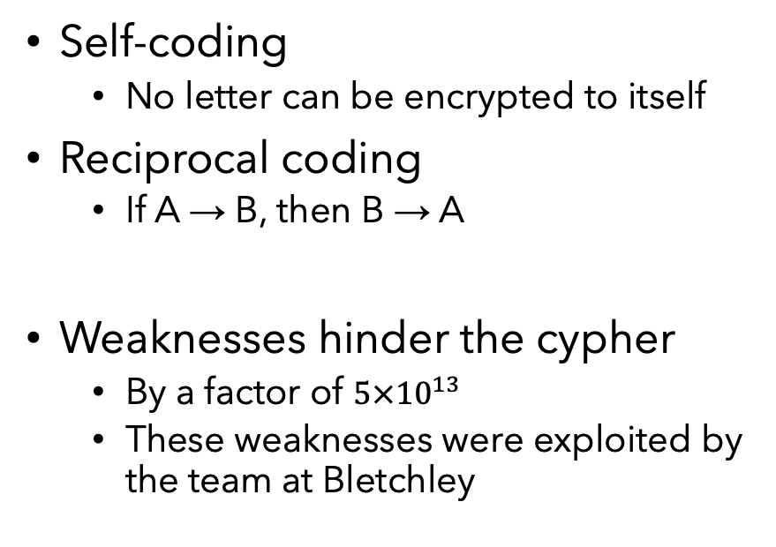
Enigma is Unbreakable!?
Enigma’s Complexity
Enigma’s Flaws
Unpredictable mechanism
Large theoretical key-space
$3×{10}^{114}$ different Enigma settings (480 bits)
Self-coding
No letter can be encrypted to itself
Reciprocal coding
If A → B, then B → A
Weaknesses hinder the cypher
By a factor of $5×{10}^{13}$
These weaknesses were exploited by the team at Bletchley
Notes:
With all these different settings and mechanisms, surely Enigma is unbreakable! This can’t be the case!
Enigma was a complex machine, creating an unpredictable mechanism that was difficult to understand, as well as boasting a large theoretical key-space of nearly
If that’s the case, then how was this cracked on a daily basis with the technology at the time?
Enigma also had crucial flaws. The first of which was Self-coding (no letter can be encrypted to itself). In addition, the Enigma’s symmetrical design created Reciprocal Coding, which means encrypt and decrypt are the same operation!
These weaknesses greatly affected the Enigma, and were key weaknesses that were exploited by the code breakers. If only there was a way around these weaknesses…

Slide 8
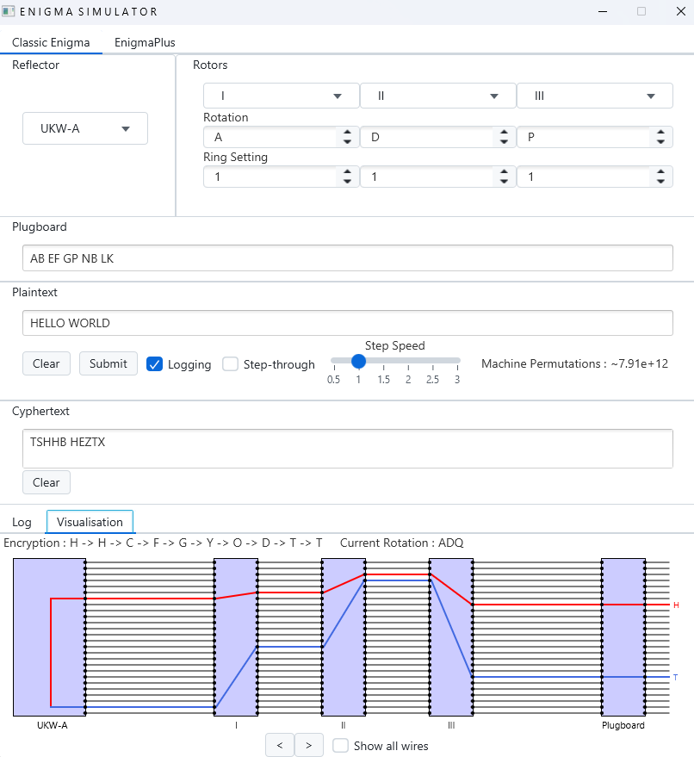
What is The Enigma Simulator? (Aims)
Accurate recreation of Enigma
An improved model “EnigmaPlus”
Fixes the flaws of Enigma
Quick and easy to use command line interface
Informative and educational GUI
Includes real-time visualisation tool!
Notes:
So what is the goal of this project? Well, it is clear that Enigma is an important part of history and this project aims to demonstrate and inspire others to learn about it.
Firstly, the project provides an accurate recreation of Enigma, allowing decryption of GENUINE messages from WW2
It provides a new model, similar to Enigma, called EnigmaPlus. Which behaves differently to provide a stronger cypher than the original Enigma
A quick and easy-to-use command line interface, allowing simple interaction with Enigma
A much more interactive and educational GUI, allowing interactions with both Enigma and EnigmaPlus
It also provides a visualisation tool, so you can see how the machine is hiding encrypting your message!

Slide 9
Let's use Enigma!
Notes:
Now you know what the project is about, lets give it a go with some roleplay!

Slide 10
Content
Subtitle
Subtitle
Add text, images, art, and videos.
Add transitions, animations, and motion.
Save to OneDrive, to get to your presentations from your computer, tablet, or phone.
Open the Design Ideas pane for instant slide makeovers.
When we have design ideas, we’ll show them to you right there.

Slide 11
Content
Subtitle
Subtitle
Subtitle
Add text, images, art, and videos.
Add transitions, animations, and motion.
Save to OneDrive, to get to your presentations from your computer, tablet, or phone.
Open the Design Ideas pane for instant slide makeovers.
When we have design ideas, we’ll show them to you right there.
This PowerPoint theme uses its own unique set of colours, fonts, and effects to create the overall look and feel of these slides.
PowerPoint has tons of themes to give your presentation just the right personality.

Slide 12

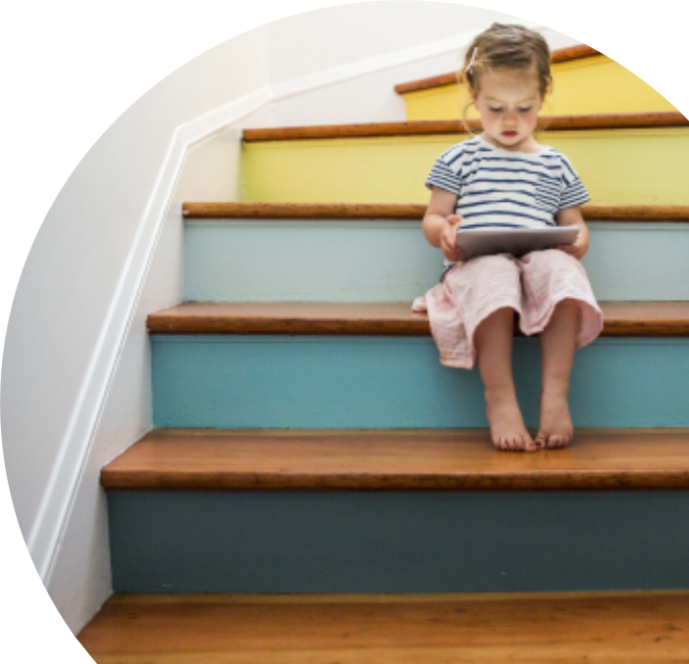
Summary
With PowerPoint, you can create presentations and share your work with others, wherever they are. Type the text you want here to get started. You can also add images, art, and videos on this template. Save to OneDrive and access your presentations from your computer, tablet, or phone.

Slide 13
Thank you
Presenter name
Email address
Website

